Slide 1
Seminar 2
Chips for driving motors(and more) used in automotive

Slide 2
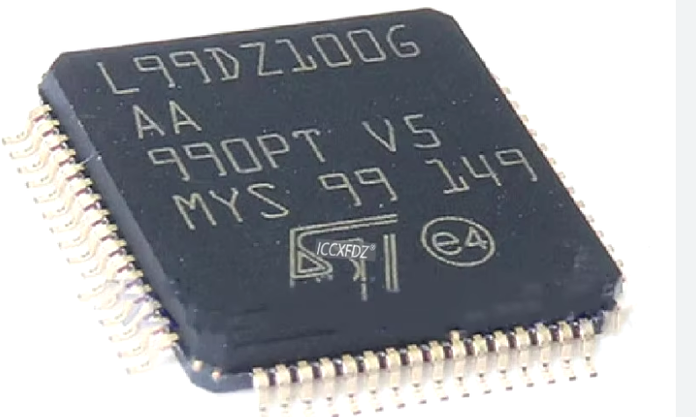
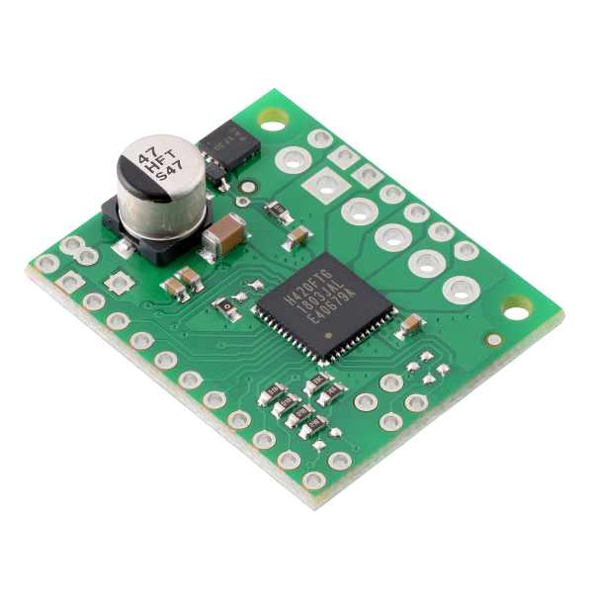
Chips in automotive
There are several categories for the chips which(and much more) which are presented.
System basis chips (SBC)
L99DZ100 (LINK)
TLE9262 (LINK)
Motor Drivers
DRV8718 (LINK)
TB67H420FTG (LINK)
(LINK)
HigVNH7070ASh Side drivers
TPS4H160 (LINK)
VND7040AJ (LINK)
Can/Lin external transceivers
TJA1054 (LINK)
TJA1021 (LINK)

Slide 3
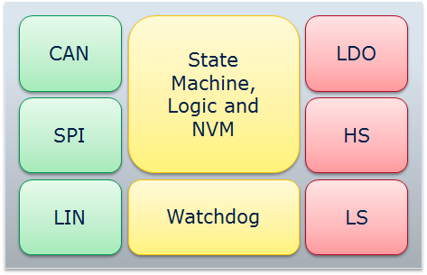
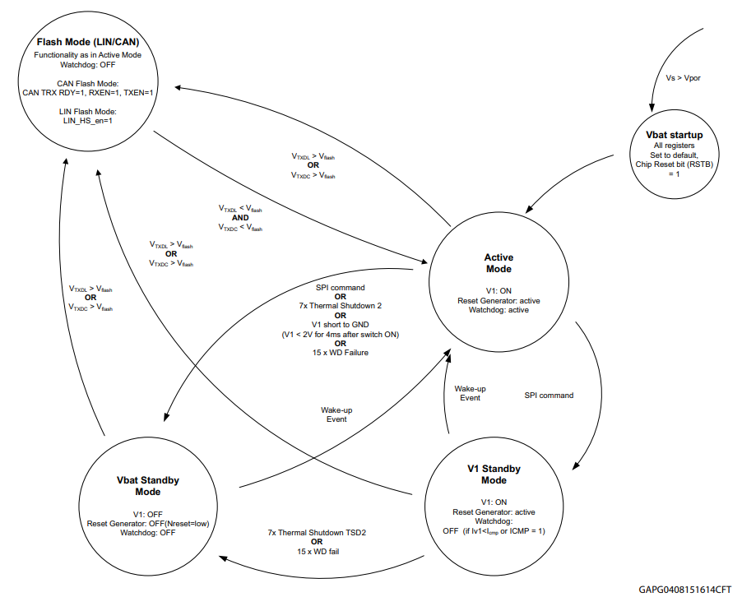
SBCs
SBC is a specific chip which is driving the power supply of the ECU.
As functionality it can have a internal CAN transceiver and some other functionality.
SBC is related also the connected to the reset pin and usually it is having internal WDG(external for the MCU).
SBC are having internal state machines used for switching the mode from Init to Run or from Run to sleep etc.(see ref diagram)
SBCs are also having LDO(low-dropout) regulator e.g.:
Form 12V to 5V output. It can have one non controllable power supply and one or more controllable supply(via SPI)
SBC chips are able to drive some HS/LS, Half bridges and Full bridge/s.
Most of the chips are supporting as mention already, CAN and/or LIN transceiver with or without partial networking.
Chips are usually driven by SPI, due complex internal logic.
To debug the SBCs there is usually special pin which turnoffs the WDG Timer

Slide 4
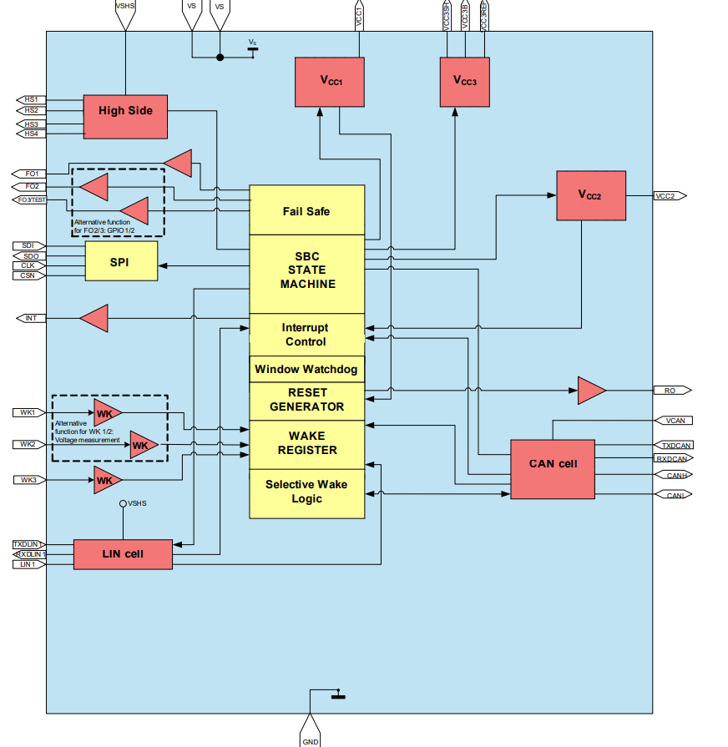
TLE9262
Chip overview:
Two integrated Low-Drop Voltage Regulators: Main regulator with 5 V up to 250 mA (3.3 V variant available) and auxiliary regulator (5 V up to 100 mA) with off-board usage protection
Voltage regulator (5 V or 3.3 V selectable) with external PNP transistor configurable for off-board usage or for load sharing
1 high-speed CAN transceiver supporting FD communication up to 5 Mbit/s featuring CAN Partial Networking & CAN FD tolerant mode according to ISO 11898-2:2016 & SAE J2284
LIN transceiver supporting LIN 2.2/ISO 17987-4/SAE J2602
4 high-side outputs 7 Ω typ., 2 HV GPIOs, 3 HV wake inputs Integrated fail-safe and supervision functions, e.g. fail-safe, watchdog, interrupt- and reset outputs
16-bit SPI for configuration and diagnostics

Slide 5
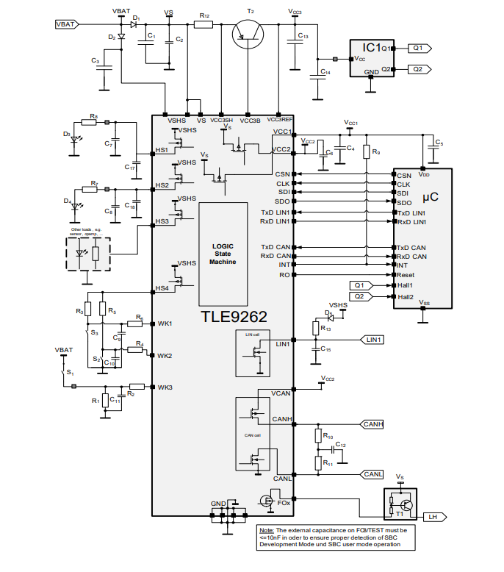
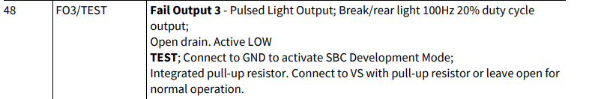
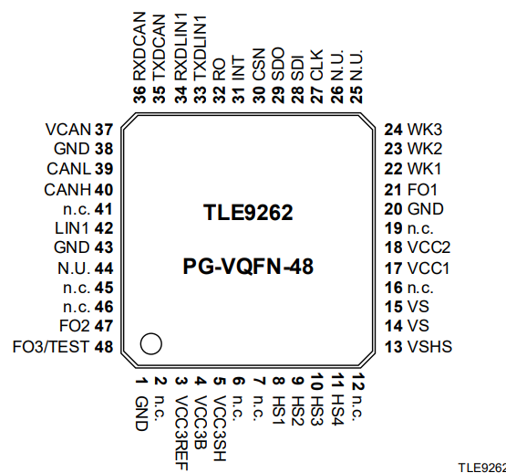
TLE9262
As already mentioned, SBC are driven by SPI. Current chip is driven by 16 Bit SPI.
The chip got 48 pins
To debug this chip pin “TEST”(48) has to be set to GND.
This is the first precondition to work with this chip. As shown on the example diagram MCU is supplied by the SBC and SBC got some LED connected to the HS.
HS can be used to supply some switches
via pull-ups.

Slide 6
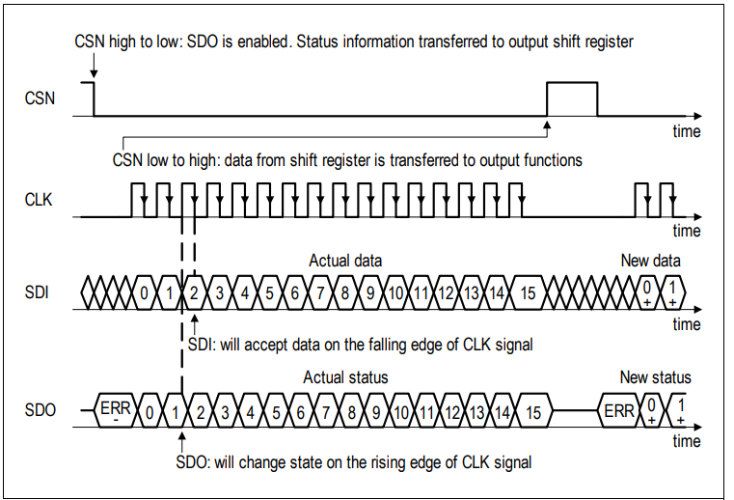
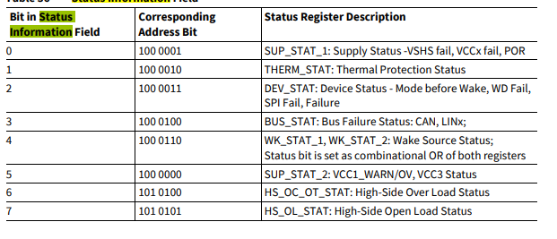
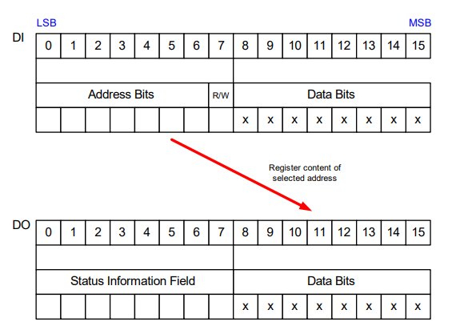
TLE9262
Driving by the SPI is happening with the following frame.
As already mentioned in the previously seminar (Seminar 1):
Data is transferred LSB first
Clock is low when idle
Data is transferred on falling edge of the clock.
Chip select is active when Low
16 bit data transfer
First byte is the address – from 0 to 6 bit
Bit 7 is operation code – r/w (0 is read, 1 is write)
Payload is from 8 to 15 bit.
Usually when sending a telegram to the SPI, chip is always responding on the first “address” byte with some status information.
On second byte it is responding with the OLD data in the requested address.
e.g.:
Writing address 0x01 OpCode:1 Data:0x55 => 0x10 | 0x01 | 0x55 > send SPI
Response: Status info field ; Old data in the address 0x01

Slide 7
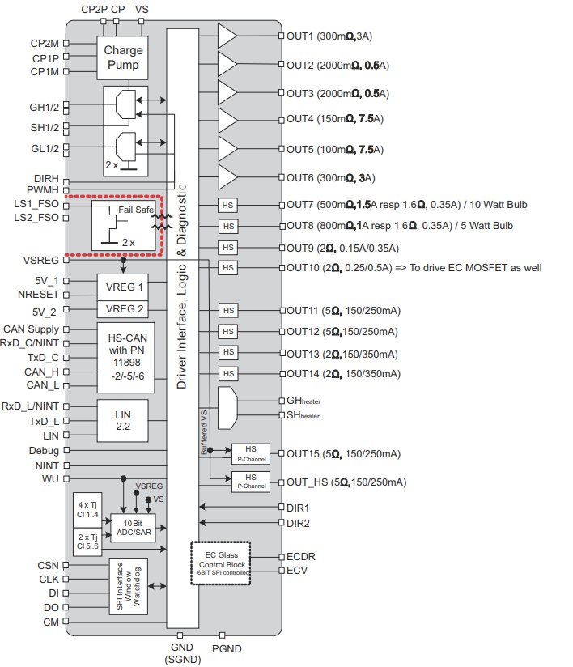
L99DZ100
L99DZ100 is a chip used in development of door modules (DZ stands for Door zone).
In comparison of TLE9262, this chip has even more functionality.
In can drive Window lifer, half bridges, high side drivers, heaters, electro chromatic glasses.
It has a CAN transceivers with partial networking and LIN transceivers.
In comparison from the TLE, chip have 64 pins
On the right, is the L99DZ100(shortly called DZ100) block diagram.
OUT1 to OUT6 is Hbridges – for driving motors
OUT7 to OUT14 are HS.
GH – Glass heater is special output used for heating of the mirror
SH – status for the Glass heater
DIR1/2 is special functionality used to drive an output directly by GPIO.
GH/GL/SH – Window lifter
DIRH/PWMH – used to drive the GH/GL

Slide 8
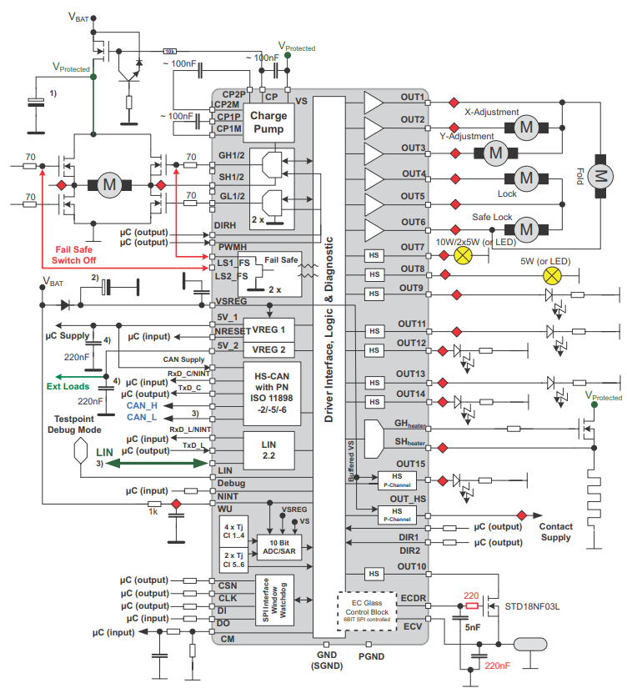
L99DZ100
This is the typical application diagram.
Here it Is showed a cascade connection of motor X,Y and FOLD for a mirror and additional connection on locking and safe lock (OUT1 and OUT6).
Out 7 to OUT14 is used for illumination.
The chip provides also diagnostics for those outputs.
In case of HS is used it can detect OL(Open load) and OC(overcurrent) flags by the SPI
Since OUT1 and OUT6 are Hbridges(HS and LS), diagnostics for them are reporting 2 types LS OC and HS OC. This has to be taken into the account.
Gate driver GH/GL are monitored by SH pin/s (middle point of both of the gate control). Monitor is read by the SW via SPI command.

Slide 9
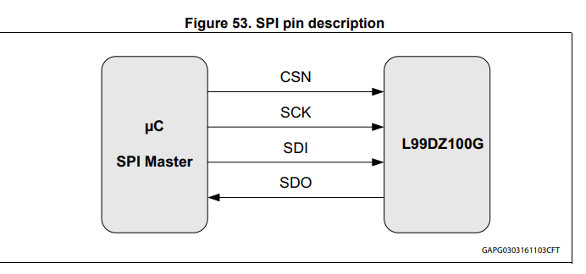
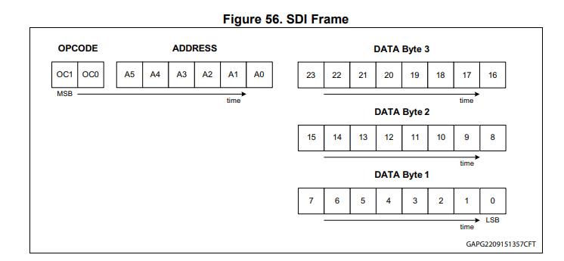
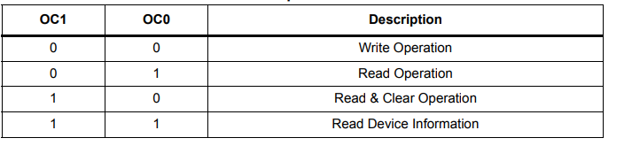
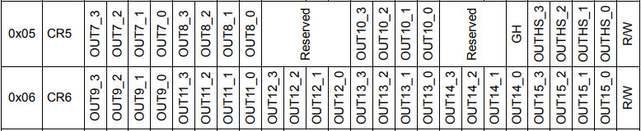
L99DZ100 – SPI control
DZ100 is controlled by SPI with the following frame:
It uses 32 bits. First 2 bits are the Opcode here and data is MSB first. SPI frame should be like this:
OPCode | Address | Payload3 | Payload 2 | Payload 1
00 0x06 0x00 0x00 0x01
This SPI command will activate the out15 and set it to High level.

Slide 10
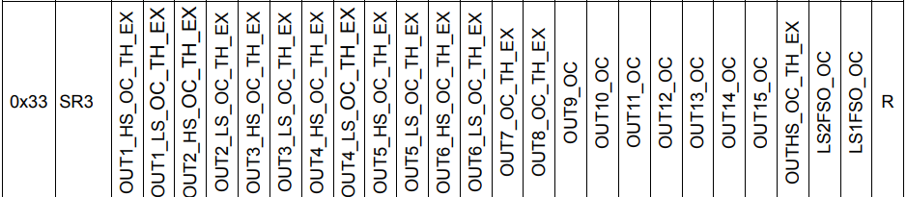
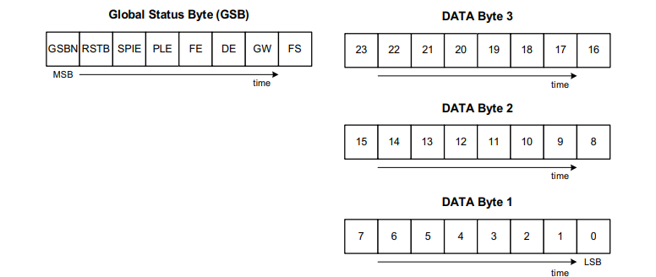
L99DZ100 - Diagnostics
Overcurrent is detected by current monitoring depending on the mode. – SR3 has to be read
OPCode | Address | Payload3 | Payload 2 | Payload 1
01 0x33 0x00 0x00 0x00
Answer:
This SPI command will activate the out15 and set it to High
GSB | Payload3 | Payload 2 | Payload 1

Slide 11
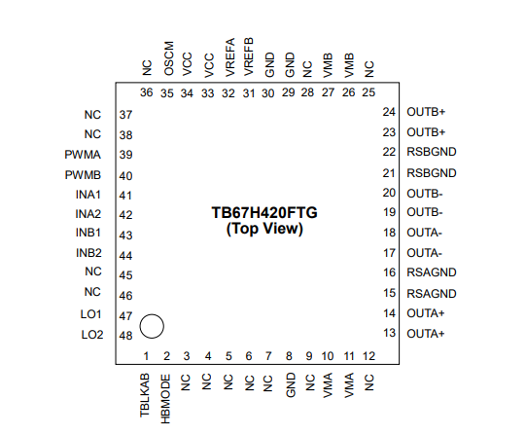
Mosfet (motor) Drivers
Motor drivers are used to drive motors……
They can have internal or external drivers.
In the lab exercise we are going to use
TB67H420FTG
This chip is used to drive 2 motors.
Out A
Out B
It is controlled by INA1,INA2,INB1,INB2 and PWMA/B
Depending on the mode based on the PWM input.
DRV8718 is MOSFET driver with 8 outputs. It is driven by SPI –
16bits

Slide 12
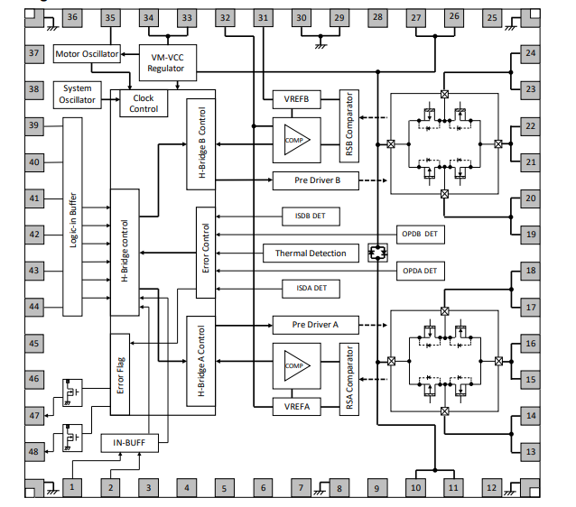
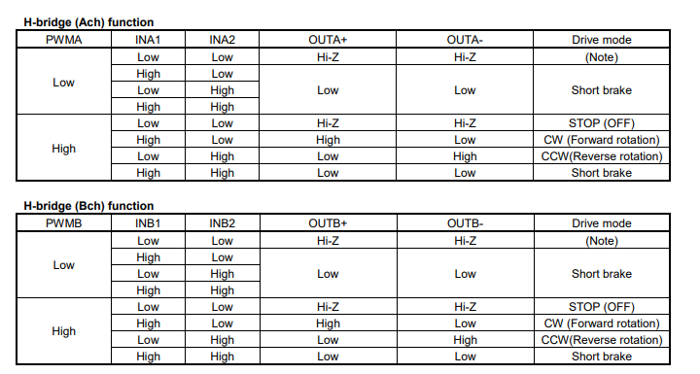
TB67H420FTG
Truth table for driving the outputs
As shown driver is driven by GPIO.

Slide 13
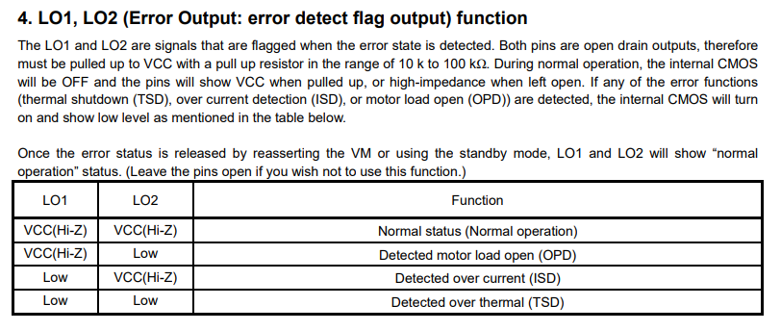
TB67H420FTG
The driver can output it state depending on the output as a feedback:

Slide 14
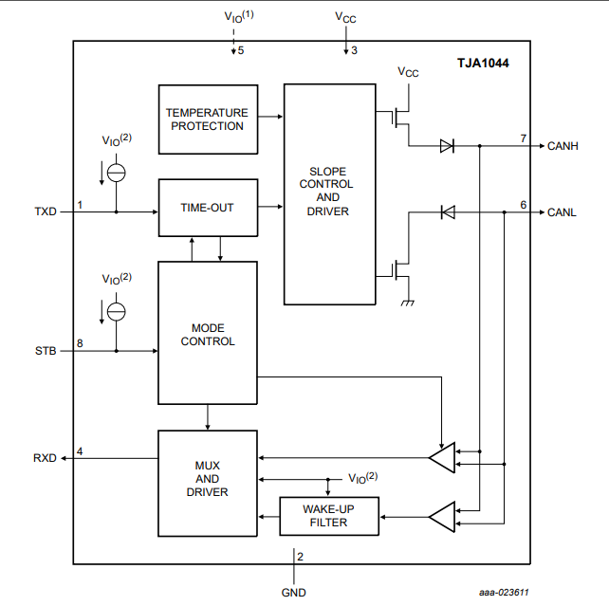
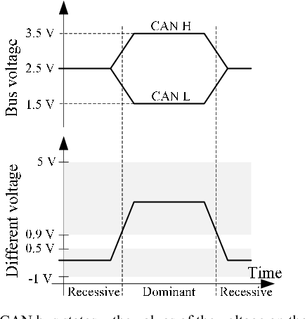
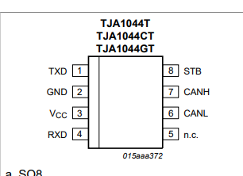
CAN transceivers
Since CAN bus is differential signal and the MCU is only working with logical levels, CAN has to be translated to a know level – 3,3V or 5V.
CAN transceivers are simple drivers that are receiving
2,5V +/- and transformed it into logical levels 0-3,3V/5V

